Slide 1
Grouping Data
CMPE 2400
Databases

Slide 2
Recap
So far, we have learned how to retrieve selected data from:
  A chosen set of columns from a single table.
    Basic select statement.
    Data from other tables used for filtering purposes.
  A chosen set of columns from two or more tables.
    select statement using join(s).
  A chosen set of columns and records from two or more tables collected into a single result set.
    Two or more select statements combined using union(s).

Slide 3
Recap
Once we have a set of data, we have looked at applying filters to the data set so that we can eliminate rows that are outside the scope of a given problem.
  Appending the where clause to a select statement.
  Use of subqueries constructed with in or exists.
Once the data has been filtered, it is often beneficial to order the data so that it is more usable.
  Enter the order by clause.

Slide 4
Recap
Finally, we have routinely used scalar functions to help us perform calculations and other manipulations on the data that we retrieve with our select statements.

Slide 5
What’s Next?
In addition to the scalar functions we have used thus far, it would be nice to get some combinational values from our database queries.
  Consider: Would it not be nice if we were able to retrieve the total of all the royalties owed to an author for all of his / her books in a single query?
    This would be preferable to getting a list of the author’s books and their associated royalties and adding them by hand.

Slide 6
Aggregate Functions
Recall that aggregate functions perform a calculation on a set of values, and return a single summarizing value.
  All aggregate functions are deterministic in nature.
  Aggregate functions may be used:
    In the select list of a select statement.
    In a having clause (more on this soon).
    In the order by clause.

Slide 7
Aggregate Functions
avg ([all | distinct] expression )
  Returns the average of the values in a group.
    all will cause all non-null values to be considered. This is default.
    distinct will cause only one of each discreet non-null value to be considered.
    expression is any numeric expression except the bit type.
      No sub-queries or nested aggregate functions permitted.
    Return type is determined by the expression type.

Slide 8
Aggregate Functions
sum ([all | distinct] expression )
  Returns the summation of all expression values in the most precise expression data type.
    all will cause all non-null values to be considered. This is default.
    distinct will cause only one of each discreet non-null value to be considered.
    expression is any numeric expression except the bit type.
      No sub-queries or nested aggregate functions permitted.
    Return type is determined by the most precise expression type.

Slide 9
Aggregate Functions
min ([all | distinct] expression )
  Returns the minimum value in the expression
    all will cause all non-null values to be considered. This is default.
    distinct will cause only one of each discreet non-null value to be considered.
    expression is any numeric or string expression except the bit type.
      No sub-queries or nested aggregate functions permitted.
    Return type is determined by the most precise expression type.

Slide 10
Aggregate Functions
max ([all | distinct] expression )
  Returns the maximum value in the expression
    all will cause all non-null values to be considered. This is default.
    distinct will cause only one of each discreet non-null value to be considered.
    expression is any numeric or string expression except the bit type.
      No sub-queries or nested aggregate functions permitted
    Return type is determined by the most precise expression type.

Slide 11
Aggregate Functions
count ({[all | distinct] expression} | * )
  Returns the number of items in a group
    all will cause all non-null values to be counted. This is default.
    distinct will cause only one of each discreet non-null value to be considered.
    expression is any data type except text, ntext, or image.
      No sub-queries or nested aggregate functions permitted.
    If the * operator is used as the option, the number of rows in a table will be counted. This includes null values.
    Return type is always type int

Slide 12
Aggregate Functions
count_big ({[all | distinct] expression} | * )
  Returns the number of items in a group
    all will cause all non-null values to be counted. This is default.
    distinct will cause only one of each discreet non-null value to be considered.
    expression is any data type except text, ntext, or image.
      No sub-queries or nested aggregate functions permitted.
    If the * operator is used as the option, the number of rows in a table will be counted. This includes null values.
    Return type is always type bigint

Slide 13
Aggregate Functions
stdev ([all | distinct] expression )
  Returns the statistical standard deviation of all values in the specified expression
    all will cause all non-null values to be considered. This is default.
    distinct will cause only one of each discreet non-null value to be considered.
    expression is any numeric expression except the bit type.
      No sub-queries or nested aggregate functions permitted.
    Return type is always type float

Slide 14
Aggregate Functions
stdevp ([all | distinct] expression )
  Returns the statistical standard deviation for the population for all values in the specified expression.
    all will cause all non-null values to be considered. This is default.
    distinct will cause only one of each discreet non-null value to be considered.
    expression is any numeric expression except the bit type.
      No sub-queries or nested aggregate functions permitted.
    Return type is always type float

Slide 15
Aggregate Functions
var ([all | distinct] expression )
  Returns the statistical variance of all values in the specified expression.
    all will cause all non-null values to be considered. This is default.
    distinct will cause only one of each discreet non-null value to be considered.
    expression is any numeric expression except the bit type.
      No sub-queries or nested aggregate functions permitted.
    Return type is always type float

Slide 16
Aggregate Functions
varp ([all | distinct] expression )
  Returns the statistical variance for the population for all values in the specified expression.
    all will cause all non-null values to be considered. This is default.
    distinct will cause only one of each discreet non-null value to be considered.
    expression is any numeric expression except the bit type.
      No sub-queries or nested aggregate functions permitted.
    Return type is always type float

Slide 17
Aggregate Example
Given an author’s ID number, retrieve the number of books the author has written, the average price of the books the author has written, and the total amount of royalty to be paid to the author on all of his or her books.
  Remember to consider the royalty percentage stored in the titleauthor table which accounts for more than 1 author writing a book.
  Embed the query into a stored procedure with the author’s ID number as the input parameter.

Slide 18
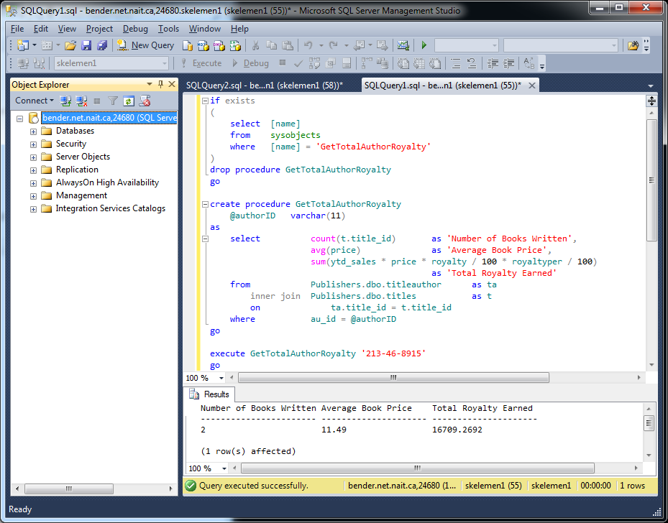
Aggregate Example

Slide 19
Aggregate Example
Seeing as only a single row shall ever be returned from the procedure we have created, this would be an excellent time to make use of output parameters.
  This would relieve the need to parse the returned values out of a result set, but will require a bit more code on the database side.
    Which way you will decide to go may often be determined by whether the database server or application server is usually under heavier load.

Slide 20
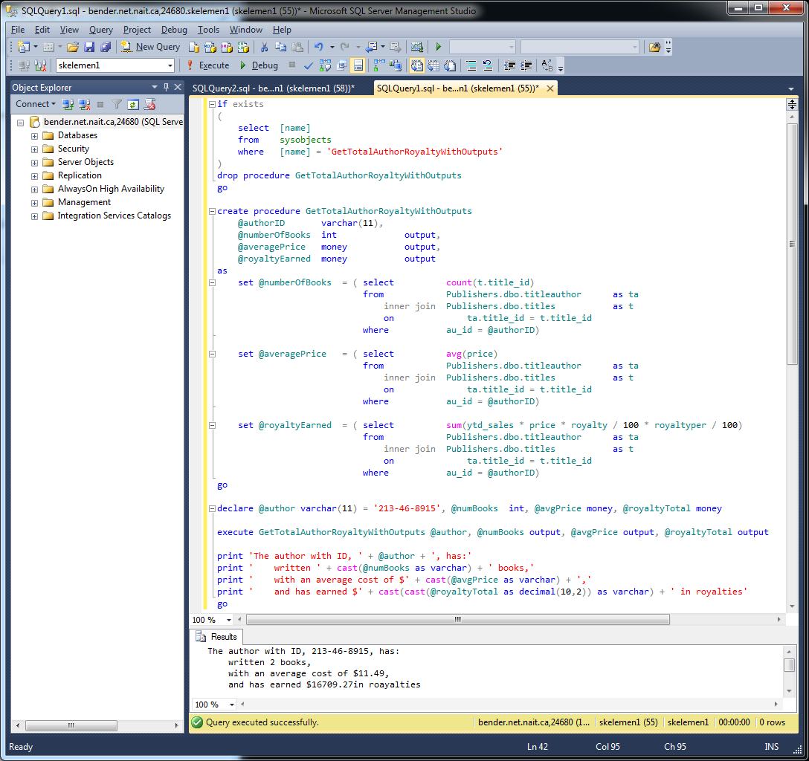
Aggregate Example

Slide 21
Now What?
When implementing the previous example, you may have noticed that if you attempt to include a column in one of the queries that is not contained within an aggregate function, an error will quickly be spawned.
  The error is very clear, and mentions the group by clause, which we shall now cover.
    See the error on the following slide

Slide 22
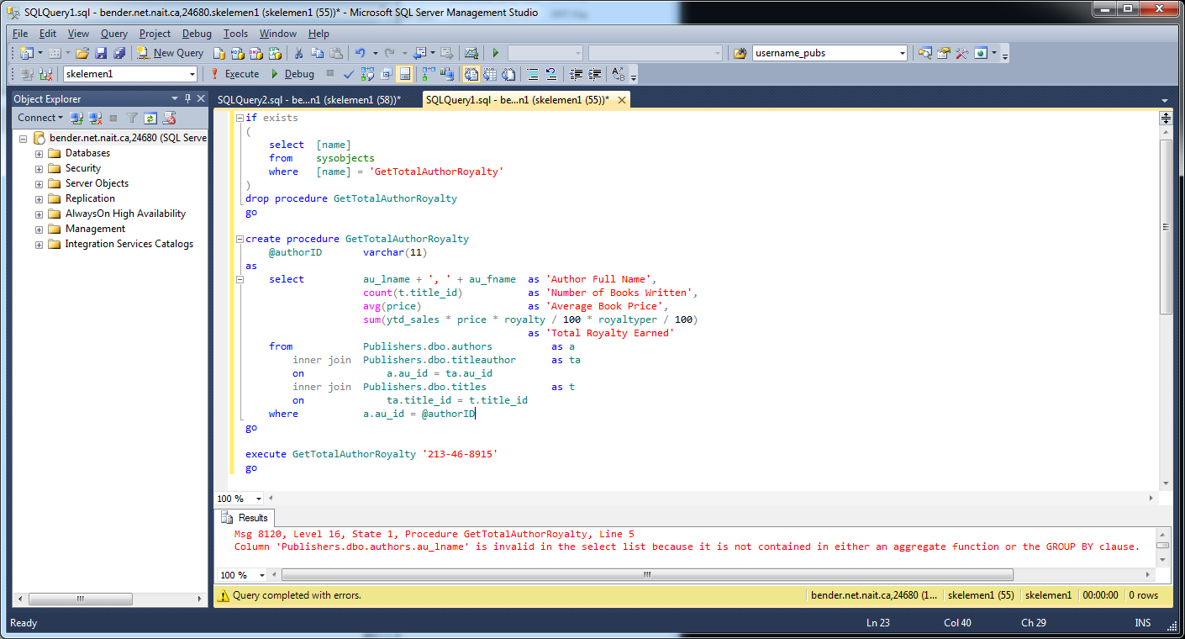
Now What?

Slide 23
Now What?
The error witnessed on the previous slide is not the only problem with the current procedure.
  With our current knowledge we must work with an entire column within our result set, not just a few rows within a column from the set.
  Consider: What if we wish to retrieve a report of the sum of royalties owed to all of the authors, listed individually, from all the books each has written.
    At present, we must repeat an aggregate query for each author that writes books for our publishing company.
    Far preferable would be the ability to have a single query which retrieves a single set of results where each author is listed next to his / her sum owed.

Slide 24
group by
The group by clause allows us to split up a set of data retrieved with a select statement into subsets of rows, but there are limitations
  Once we have specified the column(s) on which to group our data, all other columns must be contained in aggregate functions.
    This is required as the DBMS does not know which of the discrete values you wish to include in your result set.
    As already shown, the reverse is also true. Once an aggregate function is used, a group by clause must also be employed.

Slide 25
group by
syntax
select Column1, … , ColumnN,
AggregateFunction1 (), … , AggregateFunctionN ()
from TableA
inner join TableB
on TableA.Join1Column = TableB.Join1Column
inner join TableC
on Table[A-B].Join2Column = TableC.Join2Column
where RowFilter1 [and/or] RowFilter2 [and/or] … RowFilterN
group by Column1, … , ColumnN

Slide 26
group by Example
We may now eliminate the previous error witnessed by the inclusion of a column not in an aggregate function
  We may also adjust our procedure so that it is not limited to a single author.
  Note that when information is gathered about individual items, such as each author, it is wise to include a unique identifier in the group by clause, but this does not mean it must appear in the select list.
    In this case, if only author last names had been used, information for the two individual authors of the same last name would have been combined.

Slide 27
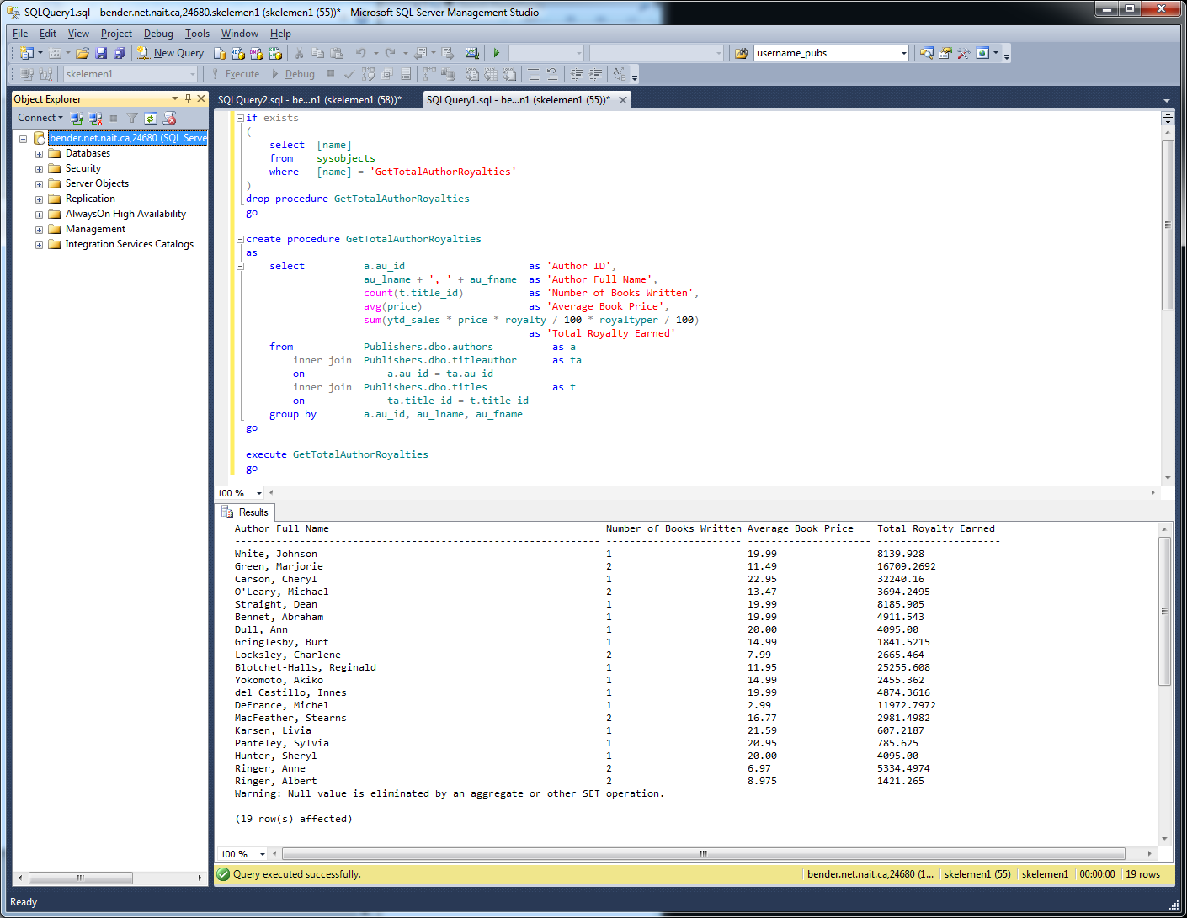
group by Example

Slide 28
group by Example
As you can see by the output of the example, the aggregate functions have automatically ignored the null witnessed within the information sets.
  Exploration of the table data will prove that the NULLs are present.

